Slide 1
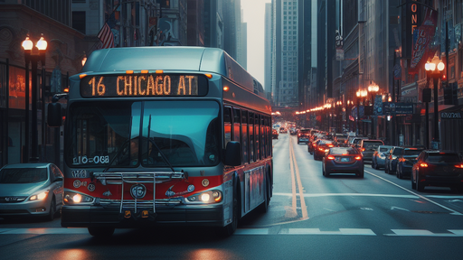
Traffic Crash Analysis
Exploring causes and trends of traffic accidents in the city of Chicago

Slide 2
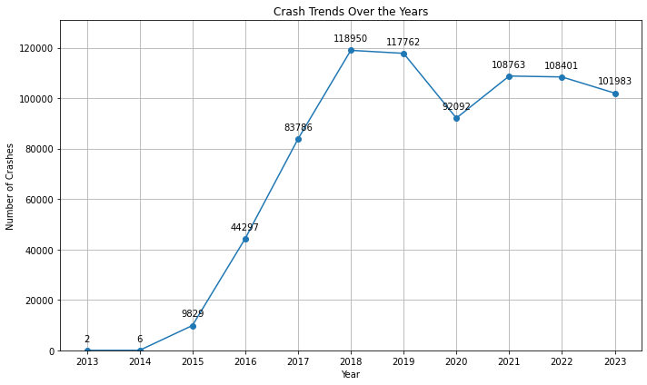
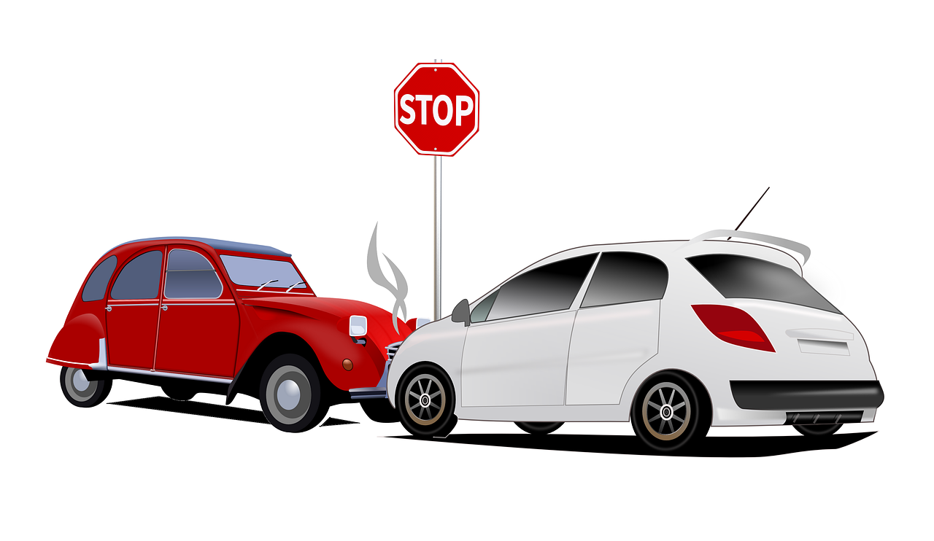
Frequency of traffic crashes over the years
The crashes count has reduced significantly during covid.

Slide 3
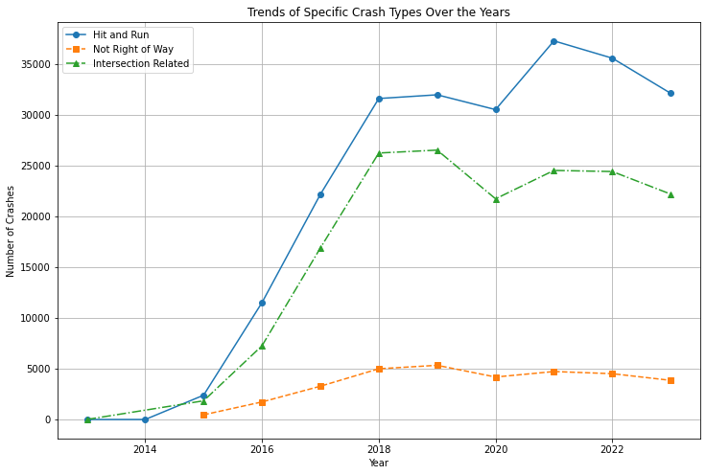

Most common types of crashes over the years
Hit and Run Incidents: There has been a significant increase in hit and run incidents over time, peaking before slightly declining.
Not Right of Way and Intersection Related Incidents: Incidents related to failing to yield the right of way and intersection-related crashes have shown fluctuations over time but have generally remained consistent and slightly decreasing, indicating a potential improvement or stabilization in these types of incidents.
This Photo by Unknown Author is licensed under CC BY-NC

Slide 4
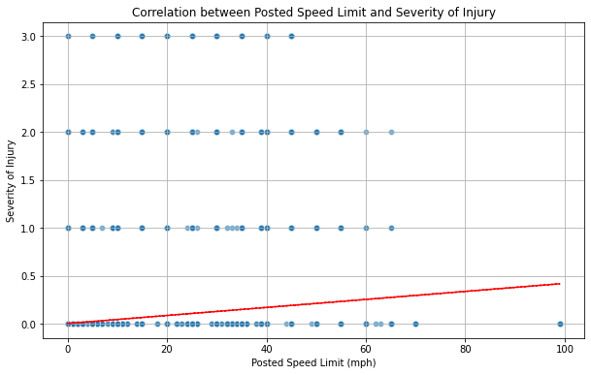
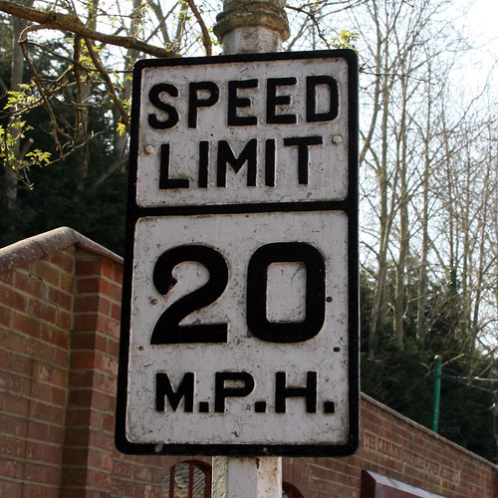
Relation between posted speed limit and the severity of injury resulting from crashes
Scatter Points: Each point on the plot represents an individual crash, plotted according to the speed limit where it occurred (x-axis) and the severity of the injury from the crash (y-axis).
Density of Points: The density of points at certain speed limits may indicate the frequency of crashes at those speeds. A higher density of points at lower speed limits could suggest that more crashes occur in these zones.
Severity Spread: The vertical spread of points at each speed limit value shows the range of injury severities associated with crashes at that speed. If points are spread higher on the y-axis at higher speeds, it might indicate that crashes at higher speeds tend to be more severe.
Trend Line: If there is a line on the plot (often called a regression or trend line), it indicates the overall direction of the relationship between speed limits and injury severity. An upward slope would suggest that higher speed limits are associated with more severe injuries.
Notes:
Scatter Points: Each point on the plot represents an individual crash, plotted according to the speed limit where it occurred (x-axis) and the severity of the injury from the crash (y-axis).
Density of Points: The density of points at certain speed limits may indicate the frequency of crashes at those speeds. A higher density of points at lower speed limits could suggest that more crashes occur in these zones.
Severity Spread: The vertical spread of points at each speed limit value shows the range of injury severities associated with crashes at that speed. If points are spread higher on the y-axis at higher speeds, it might indicate that crashes at higher speeds tend to be more severe.
Trend Line: If there is a line on the plot (often called a regression or trend line), it indicates the overall direction of the relationship between speed limits and injury severity. An upward slope would suggest that higher speed limits are associated with more severe injuries.

Slide 5
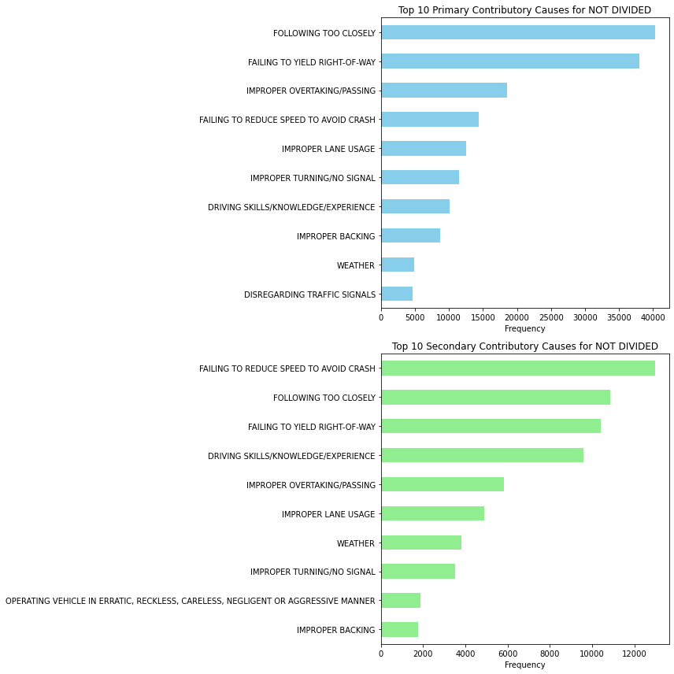
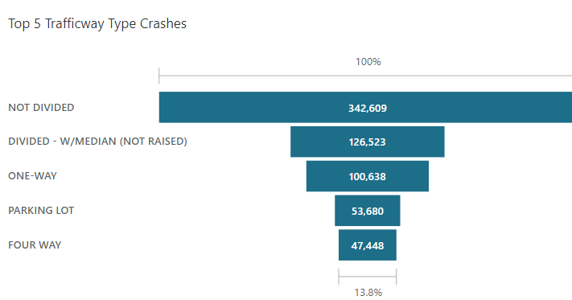
Most common type of crash and the reasons for it
Over 43% crashes are Not Divided type of crashes and the primary and secondary reasons for this are on the right.

Slide 6
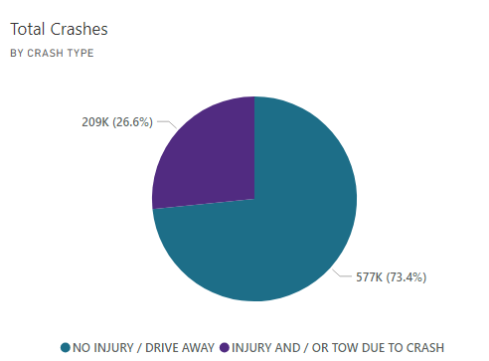
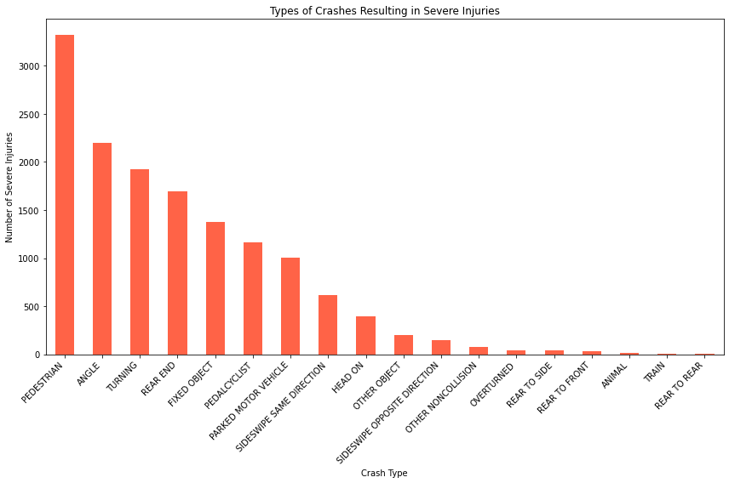
Injuries Statistics
Most of the crashes about 73% don’t cause any injuries. Most common reasons for the ones that do cause injuries are mentioned on the right.

Slide 7
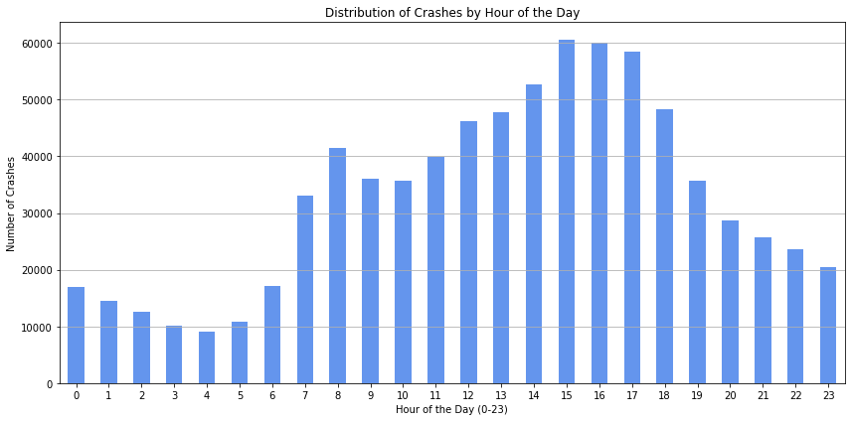
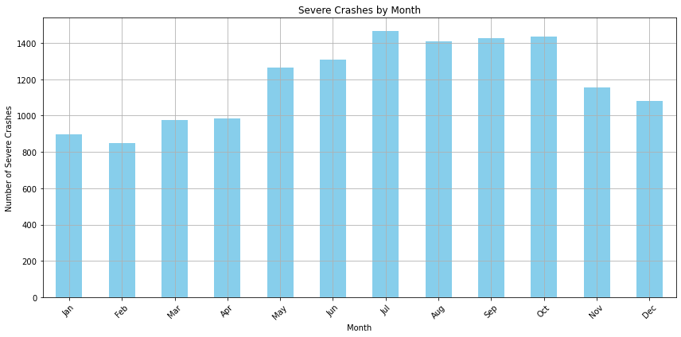
When do most crashes even happen?
Most of the crashes are happening around rush hour(4pm-6pm), if we could increase more frequent public transportation during this time, it would be beneficial to employees, students etc.
Crashes also peaked in summer months(vacations, school breaks which means teen drivers, more motor bikes on streets, heat effecting vehicle performance etc). We could potentially create more awareness to public regarding safety precautions.

Slide 8
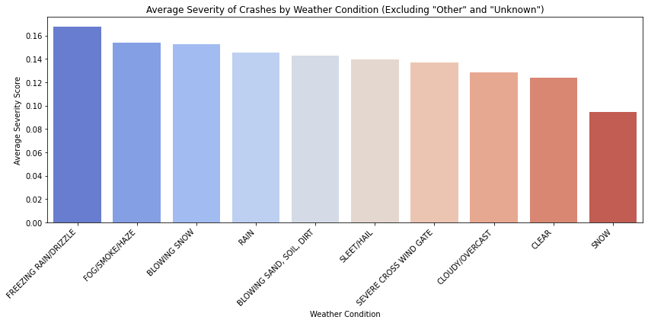
How does weather affect the crashes and the severity of the injuries for people involved in crashes?

Slide 9
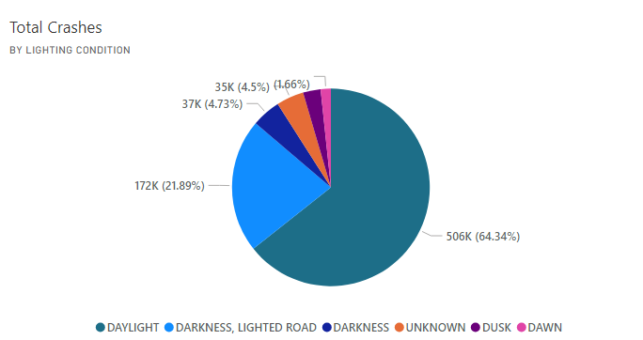
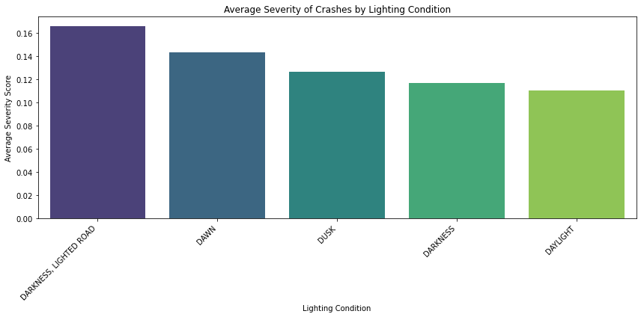
How does Lighting condition affect the severity of the injuries for people involved in crashes and what is the lighting condition where most crashes occur ?

Slide 10
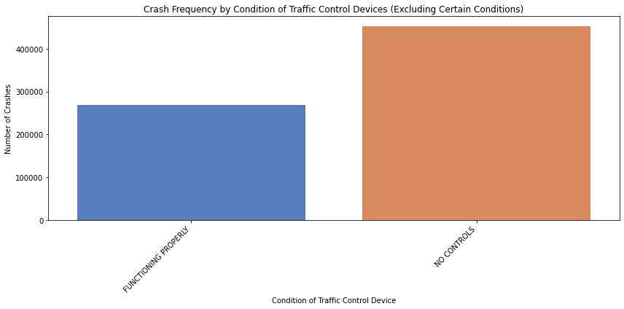
Correlation between traffic control devices and no.of crashes

Slide 11
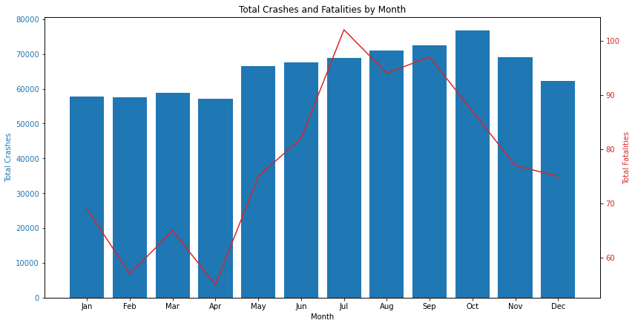
Are there more fatalities in certain months?
July does have higher fatalities compared to other months , one reason could be : Chicago has so many live events, recreational activities, celebrations etc in July which brings large crowds of people or bicyclists to the streets.

Slide 12
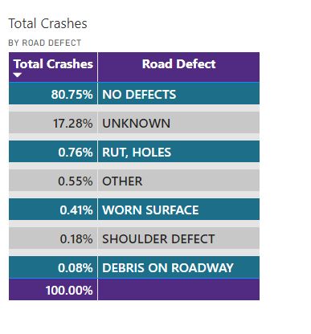
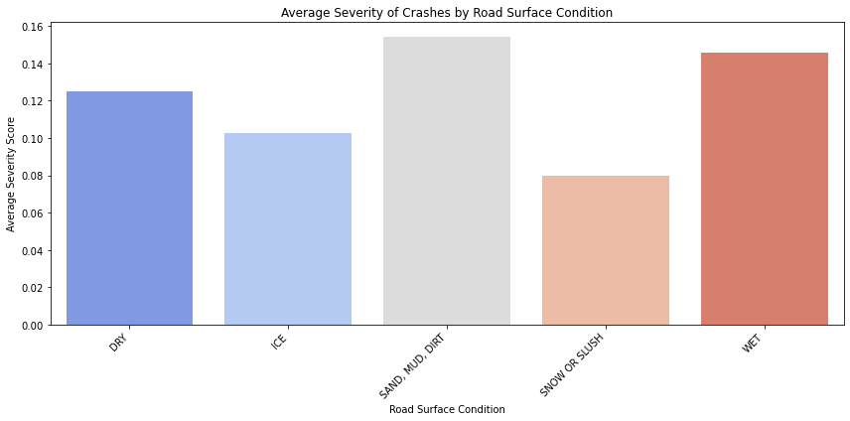
Which type of road conditions cause more severe injuries ?
Chicago’s roads are good!!

Slide 13
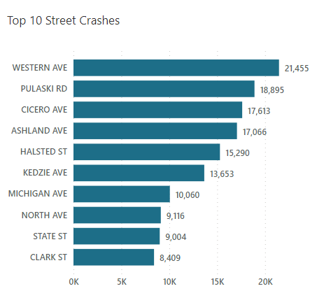
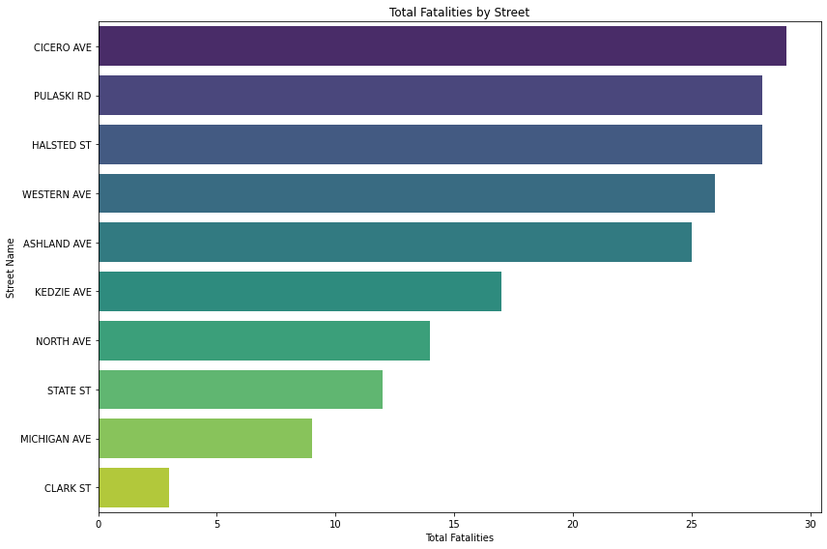
What places to look out for and take more precaution?

Slide 14
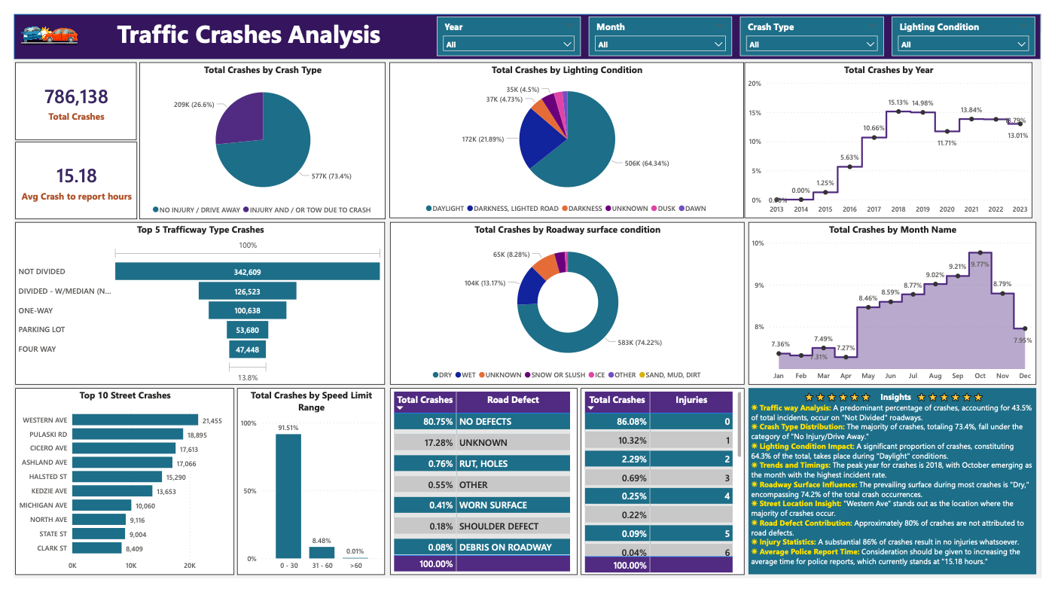
The Big Picture

